Slide 1
Addressing Phishing Attacks at Heaven Systems
Daniel Pratama
18268
Date: 12/05/2023

Slide 2
Introduction
Introduction of the issue of increased phishing attacks and the impact on Heaven Systems' productivity
In recent times, Heaven Systems has been experiencing an increase in phishing attacks that are reaching employee inboxes. This has introduced the risk of a data breach, leading to a decrease in productivity as end-users wait for the IT department to investigate suspicious emails. The phishing attacks have become more specific and sophisticated, making it challenging for employees to identify them, and causing IT staff to spend a significant amount of time investigating suspicious emails. The impact of these attacks has raised concerns within the company and the need for a solution to detect and respond to suspicious emails quickly and effectively.

Slide 3
The need for a solution to detect and respond to suspicious emails quickly and effectively
The need for a solution to detect and respond to suspicious emails quickly and effectively is critical for Heaven Systems to prevent potential data breaches and improve productivity. While there are multiple layers of security to filter email as it enters Heaven Systems' network, it is still possible for targeted phishing emails to slip through and get into employee inboxes. The current process of relying on end-users to determine whether an email is safe to open is not foolproof, leading to an increase in suspicious emails and an unnecessary workload for IT staff. Therefore, there is a need for a more automated and efficient system that empowers end-users to report suspicious emails directly from their inbox and reduces the workload on the IT staff.

Slide 4
MailMon - Automated Phishing Incident Reporting and Response Service
Overview of MailMon as an automated phishing incident reporting and response service
MailMon is an automated phishing incident reporting and response service that Heaven Systems has implemented to help detect and respond to suspicious emails quickly and effectively. It is an Outlook plug-in that runs on Microsoft Exchange 2013 or newer and Office365. The plug-in empowers end-users to report suspicious emails directly from their inbox, which triggers a response from the IT department. MailMon automates the analysis of the suspicious email, allowing IT staff to quickly assess the email's risk and take appropriate action. This system helps to reduce the workload on the IT department while improving the overall efficiency of handling suspicious emails.

Slide 5
MailMon runs on Microsoft Exchange 2013 or newer and Office365, and is deployed to end users as an Outlook plug-in
MailMon is designed to work with Microsoft Exchange 2013 or newer and Office365 environments, and it is deployed as an Outlook plug-in for end-users. The plug-in appears as an additional option within the Outlook application, allowing users to report suspicious emails directly from their inbox by clicking on a button. Once a user clicks on the button, the suspicious email is automatically forwarded to the IT department, triggering the MailMon response process. This system is user-friendly and easy to deploy, allowing for a seamless integration with the current email system used by Heaven Systems.

Slide 6
Benefits of MailMon
MailMon provides several benefits for Heaven Systems, including:
Increased efficiency in detecting and responding to suspicious emails: The automated process of reporting and responding to suspicious emails allows the IT department to quickly assess the email's risk and take appropriate action. This results in a quicker resolution time and helps prevent potential data breaches.
Empowers end-users to report suspicious emails directly from the inbox: With the MailMon plug-in, end-users can easily report suspicious emails by clicking on a button within their inbox. This empowers end-users to take an active role in preventing potential data breaches and phishing campaigns.
Reduces the workload on IT staff in investigating suspicious emails: The automation of the process reduces the workload on the IT staff, freeing up time to focus on other critical tasks. This results in an overall increase in productivity for the IT department.
Overall, the implementation of MailMon has improved the efficiency of detecting and responding to suspicious emails, empowered end-users, and reduced the workload on the IT staff.

Slide 7
IT Service Agreement and Severity Levels
The IT Service Agreement is a framework that outlines the severity levels for IT incidents within Heaven Systems. The agreement provides guidelines for the response time required for each level of severity. The severity levels range from 1 (Outage) to 5 (General), as follows:
Outage: This is the most severe level, where the entire company server is down, and the response time required is immediately.
Critical: This level is where the entire department server is down, and the response time required is within 15 minutes.
Urgent: This level is where staff computers are down, and the response time required is within 1 hour.
Important: This level is where staff computers are not working correctly or have the potential to interrupt their routine work, and the response time required is within 3 hours.
General: This level is for incidents such as software upgrades or training requests, and the response time required is within 48 hours.
The severity levels provide a clear framework for the response time required for each level of severity, ensuring that the IT department prioritizes incidents based on their severity level. The severity levels also ensure that incidents are handled in a timely and efficient manner, reducing the impact on productivity and preventing potential data breaches.

Slide 8
Conclusion
The identified issue within Heaven Systems is an increase in phishing attacks, which is introducing the risk of a data breach and causing a decrease in productivity. To address this issue, Heaven Systems has implemented MailMon, an automated phishing incident reporting and response service that empowers end-users to report suspicious emails directly from their inbox, reducing the workload on the IT staff and improving efficiency.
The implementation of MailMon provides several benefits, including increased efficiency in detecting and responding to suspicious emails, empowering end-users to take an active role in preventing data breaches, and reducing the workload on IT staff.
Increasing awareness of cyber security incidents among employees and IT staff is also crucial for better response and prevention. By educating employees on the red flags to look for in phishing emails and providing regular training to IT staff, Heaven Systems can improve their overall cyber security posture.
In summary, implementing MailMon provides an effective solution to address the issue of increased phishing attacks, increasing efficiency, and reducing the workload for IT staff. Increasing awareness of cyber security incidents among employees and IT staff is also crucial for better response and prevention.

Slide 9
Stop Phishing Scam Email

Slide 10
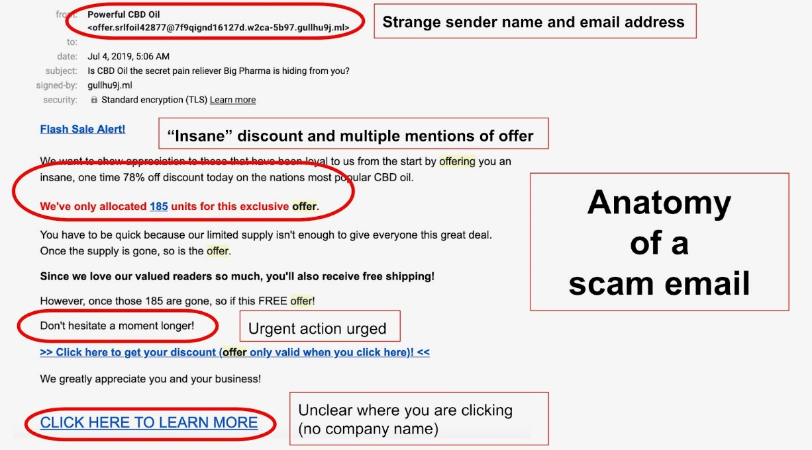
When you see your email like:

